Slide 1



K. J. Somaiya Institute of Information Technology, Mumbai
Department of Electronics and Telecommunication Engineering
Academic Year 2023-2024
Major Project-A Sem-VIII
Design of Forward Problem for Early Detection of Breast Cancer using Electrical Impedance Tomography (EIT) Technique
PRATHAMESH AWATE - LY-32
BHAVESH PATEL - LY- 50
YASH SALUNKHE -LY- 58
Dr. Priya T. Hankare

Slide 2
Outline of Major A Project Presentation
Abstract
Introduction
Objective
Literature Survey
Social/Medical/Agricultural/Industry relevance
Block Diagram and its Explanation
Software and Hardware requirements
Results and Discussion
Conclusion
Future Scope
Applications
References

Slide 3
ABSTRACT :
This research presents design and development of a forward problem solver for early detection of breast cancer using Electrical Impedance Tomography (EIT) technique. The forward problem, which involves predicting the electrical measurements based on the internal conductivity distribution, is a fundamental aspect of EIT. This study focuses on the formulation and numerical implementation of the forward problem, considering the complexities of breast tissue and electrode arrangements. The proposed forward solver incorporates realistic tissue models and electrode configurations to enhance the accuracy of impedance predictions.

Slide 4
INTRODUCTION :
Breast malignancy is the major and common reasons for demise due to cancer among ladies. Primary prevention is not possible since the cause of this disease is not known. The likelihood of developing breast cancer increases with age and the majority hazardous factors contribute its growth.
If it is detected in its early stage the success of treatment is more thereby increasing the survival rate. Currently various screening and diagnostic methods are available such as Breast self and clinical Examination, Mammography, Ultrasonography, Infrared Thermography, Magnetic Resonance Imaging.

Slide 5
PROBLEM STATEMENT :
Design of AC current source
Automatic switching of current and voltage electrodes

Slide 6

LITERATURE SURVEY :
Breast malignancy is most widely recognized illness among ladies around the world. Cancer is said to occur when cells in the body begin to grow in an uncontrollable manner. Typically cells develop in an organized manner, however malignant growth cells grow to develop and crowd into ordinary cells. Since, currently there is no known way of preventing breast cancer, early detection permits more treatment options before cancer spreads to different parts of the body, thereby increasing survival rate. Various advanced imaging and screening techniques are available to detect breast cancer.
The various types of screening techniques are :-
1. Breast Self Assessment (BSA) and Clinical Breast Assessment (CBA)
2. Mammography
3. Ultrasonography or Ultrasound
4. Infrared Thermography or Thermal Imaging
5. Magnetic Resonance Imaging (MRI)
6. Electrical Impedance Tomography (EIT)

Slide 7
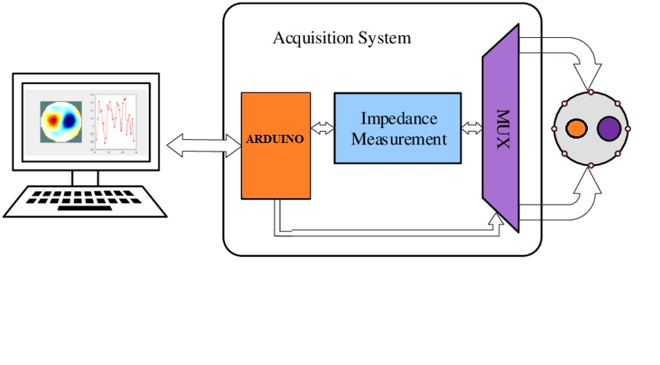
ELECTRICAL IMPEDANCE TOMOGRAPHY TECHNIQUE :
Typically, conducting surface electrodes are attached to the skin around the body part being examined. Small alternating currents will be applied to some or all of the electrodes, the resulting equi-potentials being recorded from the other electrodes.

Slide 8
ELECTRICAL IMPEDANCE TOMOGRAPHY PRINCIPLE :
Electrical Impedance Tomography (EIT) is a sophisticated medical imaging technique that involves injecting small electrical currents into a body and measuring resulting voltage changes on its surface.
Using Arduino, a multiplexer, voltage measurements, and phantoms (simulated body models), you can create a simplified setup to explore the basic principles of EIT. However, please note that this approach might not achieve the accuracy and sophistication of dedicated EIT systems.

Slide 9
CURRENT INJECTION TECHNIQUES :
1. Adjacent Current Injection (ACI)
2. Opposite Current Injection (OCI)
3. Trigonometric Current Injection (TCI)
4. Cross Current Injection (CCI)

Slide 10
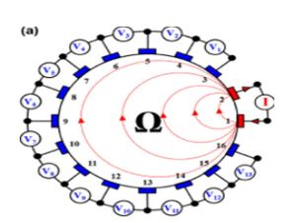
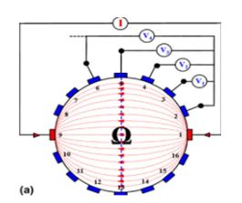
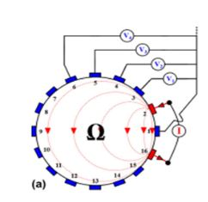
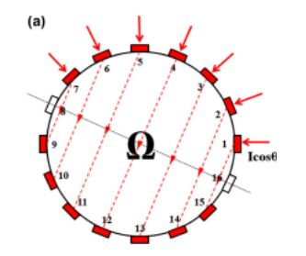
CURRENT INJECTION TECHNIQUE FIGURES :
Fig. 1 Adjacent Current Injection
Fig. 2 Opposite Current Injection
Fig. 3 Trigonometric Current Injection
Fig. 4 Cross Sectional Injection

Slide 11
Parameters | Adjacent Current Injection | Opposite Current Injection | Trigonometric Current Injection | Cross Current Injection
Definition- | EIT is a medical imaging technique that utilizes electrical measurements to create images of the internal conductivity distribution of a body[4]. ACI involves injecting electrical current through a pair of adjacent electrodes and measuring the resulting voltage changes on another adjacent pair of electrodes. | Opposite Current Injection is an another alternative current injection method proposed by Hua Etnal. In this method current is injected through two diametrically opposed electrodes in each current projection and hence the method is known as the opposite method[4]. | Trigonometric Current Injection is a current injection method proposed by Gisser ay el. Here the current is injected through all electrodes[4]. Because current flows through all electrodes simultaneously, as many independent current injectors are needed as are the electrodes used in EIT system and hence a 16-electrode EIT system needs 16 current injectors. | Cross Current Injection technique involves injecting current through one pair of electrodes on one side of the body and measuring voltages on a set of electrodes that encircle the body[4]. CSI is particularly useful for imaging large-scale conductivity variations, making it suitable for applications such as cardiac and lung function monitoring.
Advantages- | Reduced Artifacts Dynamic Imaging | Precise Localization Enhanced Sensitivity | Improved Image Quality Enhanced Tissue Differentiation Real-Time Imaging | Improved Spatial Coverage Enhanced Image Resolution
Disadvantages- | Complexity of Image Reconstruction Limited Depth Penetration | Limited Depth Information Interference from Nearby Tissues | Complexity of Implementation Risk of Overfitting | Challenging for Real-Time Imaging Limited Clinical Integration

Slide 12
METHODOLOGY USED IN CURRENT INJECTION TECHNIQUES :
Electrode Placement: In ACI, a pair of current-carrying electrodes is placed adjacent to each other on the surface of the body. Another pair of voltage-sensing electrodes is also positioned adjacent to each other, typically in close proximity to the current electrodes.
Current Injection: A small electrical current is introduced through the current-carrying electrodes. This injected current flows through the body and follows the path of least resistance, encountering different tissues with varying conductivities.
Voltage Measurement: The voltage changes that occur due to the injected current are measured using the voltage-sensing electrodes. These voltage measurements provide information about the conductivity distribution within the body.
Image Reconstruction: Using the collected voltage measurements, an algorithm is used to reconstruct an image of the internal conductivity distribution. This involves solving an inverse problem to estimate the conductivity values within the body based on the observed voltage changes.

Slide 13
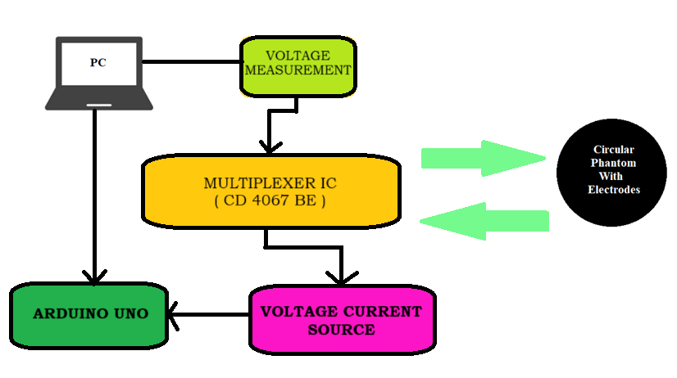
BLOCK DIAGRAM AND IT’S EXPLANATION :

Slide 14
WORKING :
Electrode Setup: Attach voltage sensing electrodes (simulate using wires) to the body phantom at specific positions.
Current Injection: Inject a small electrical current into the phantom. This can be simulated using an external current source. Arduino could control the current source if interfacing is possible.
Voltage Measurement Setup: Connect voltage sensing electrodes to the multiplexer's input channels. The multiplexer allows you to sequentially measure voltage changes across different electrode pairs.
Multiplexer Control: Use Arduino to control the multiplexer. Select each input channel one by one to measure voltage changes.
Voltage Measurement: For each selected input channel, measure the voltage using Arduino's analog-to-digital converter (ADC). Voltage changes are due to the injected current interacting with the phantom's conductivity distribution.
Data Collection: Collect voltage measurements for each channel pair. These measurements represent the changes in electrical potential resulting from the injected current.
Signal Processing: Process the collected voltage data. You might perform basic operations such as calibration, noise reduction, and calculating impedance changes.
Image Reconstruction (Simplified): Using the collected voltage data, perform a basic form of image reconstruction. This might involve simple algorithms like pixel-wise subtraction or a basic model to estimate conductivity changes within the phantom.
Visualization: Display the reconstructed image or impedance changes on a simple user interface. Arduino's capabilities for graphical display might be limited, but you could use a computer for visualization.

Slide 15
HARDWARE REQUIREMENTS :
Arduino board (Arduino Uno)
Multiplexer (CD74HC4067)
Electrodes
Plastic Phantom with Saline water
AC Current Source

Slide 16
SOFTWARE REQUIREMENTS :
ARDUINO IDE
MATLAB

Slide 17
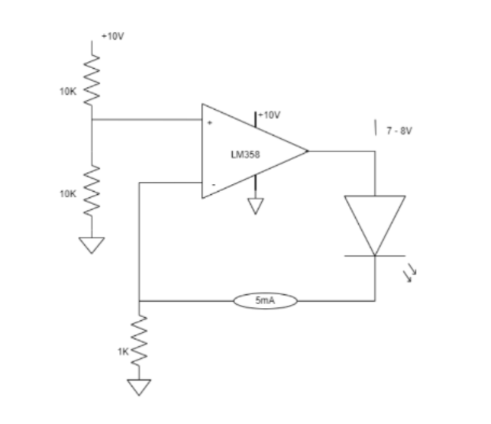
AC CURRENT SOURCE CIRCUIT :

Slide 18
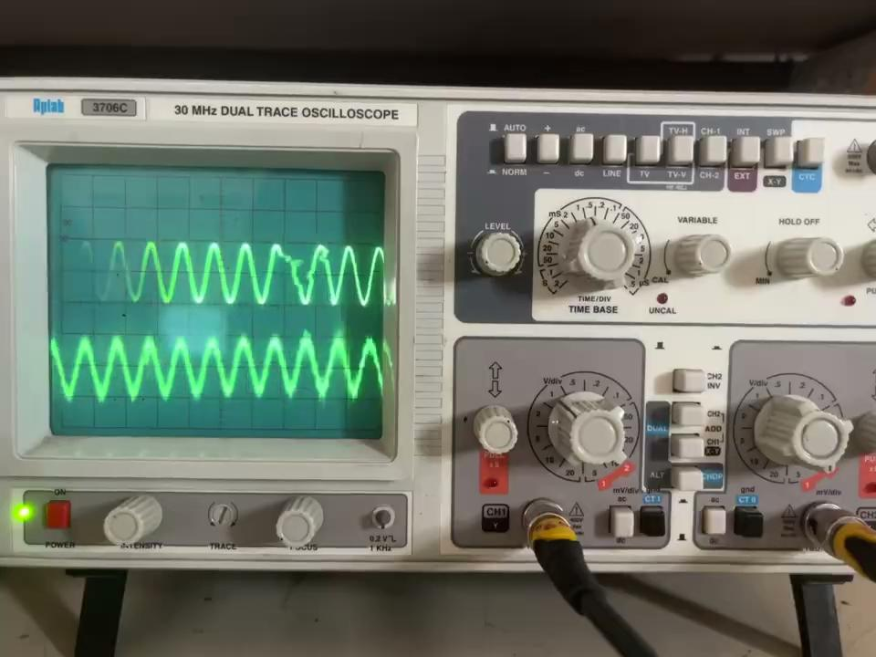
AC CURRENT SOURCE :

Slide 19
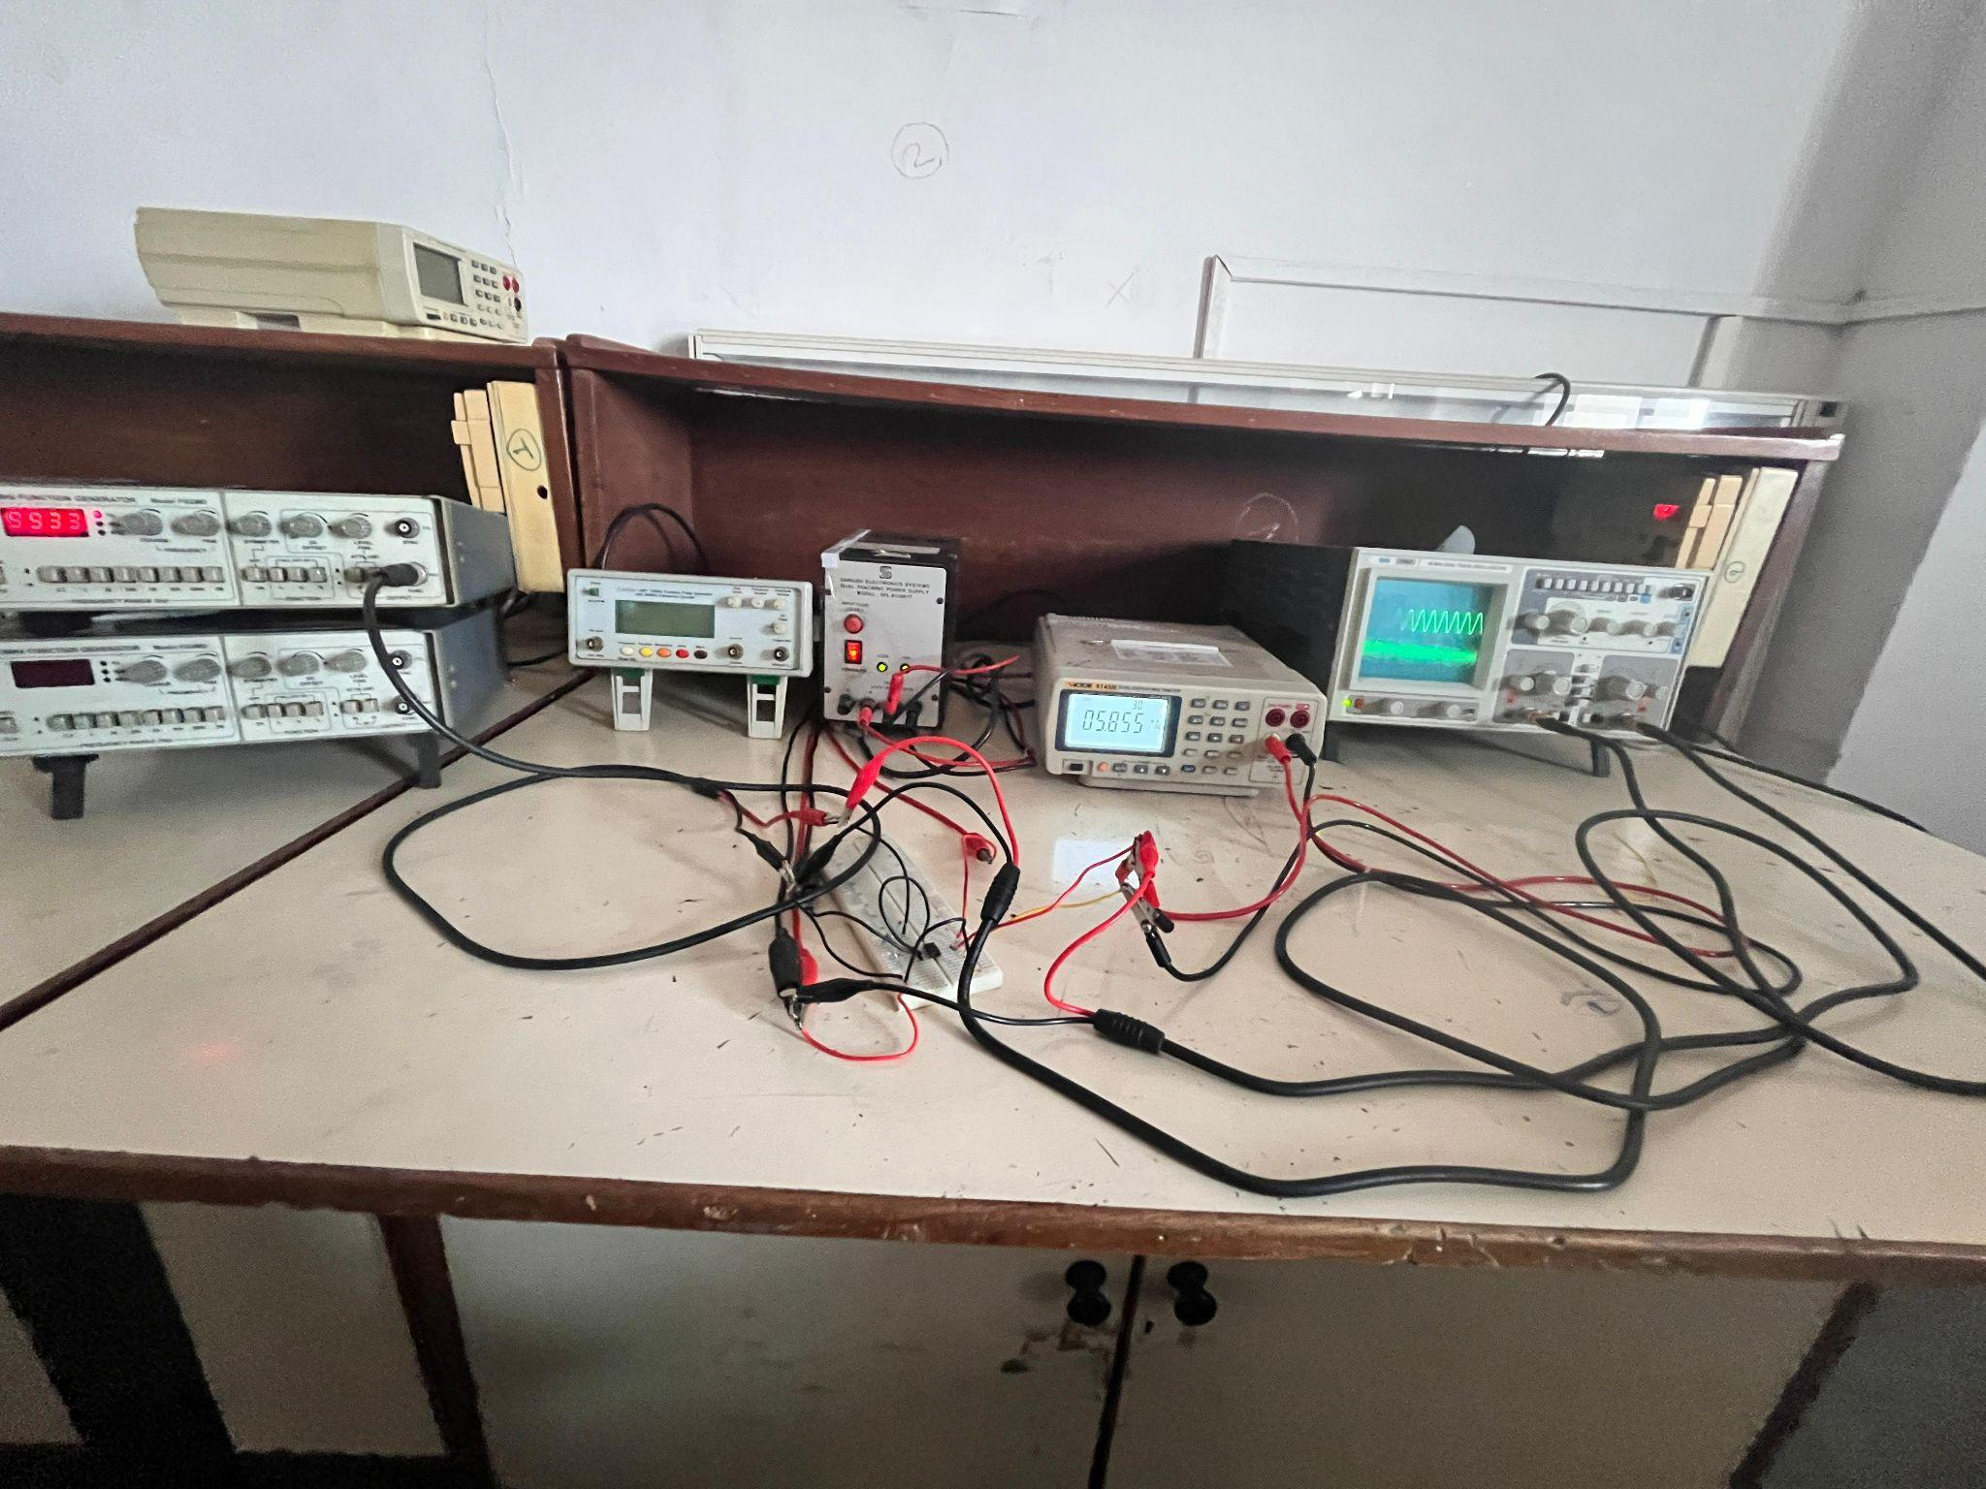
AC CURRENT SOURCE :

Slide 20
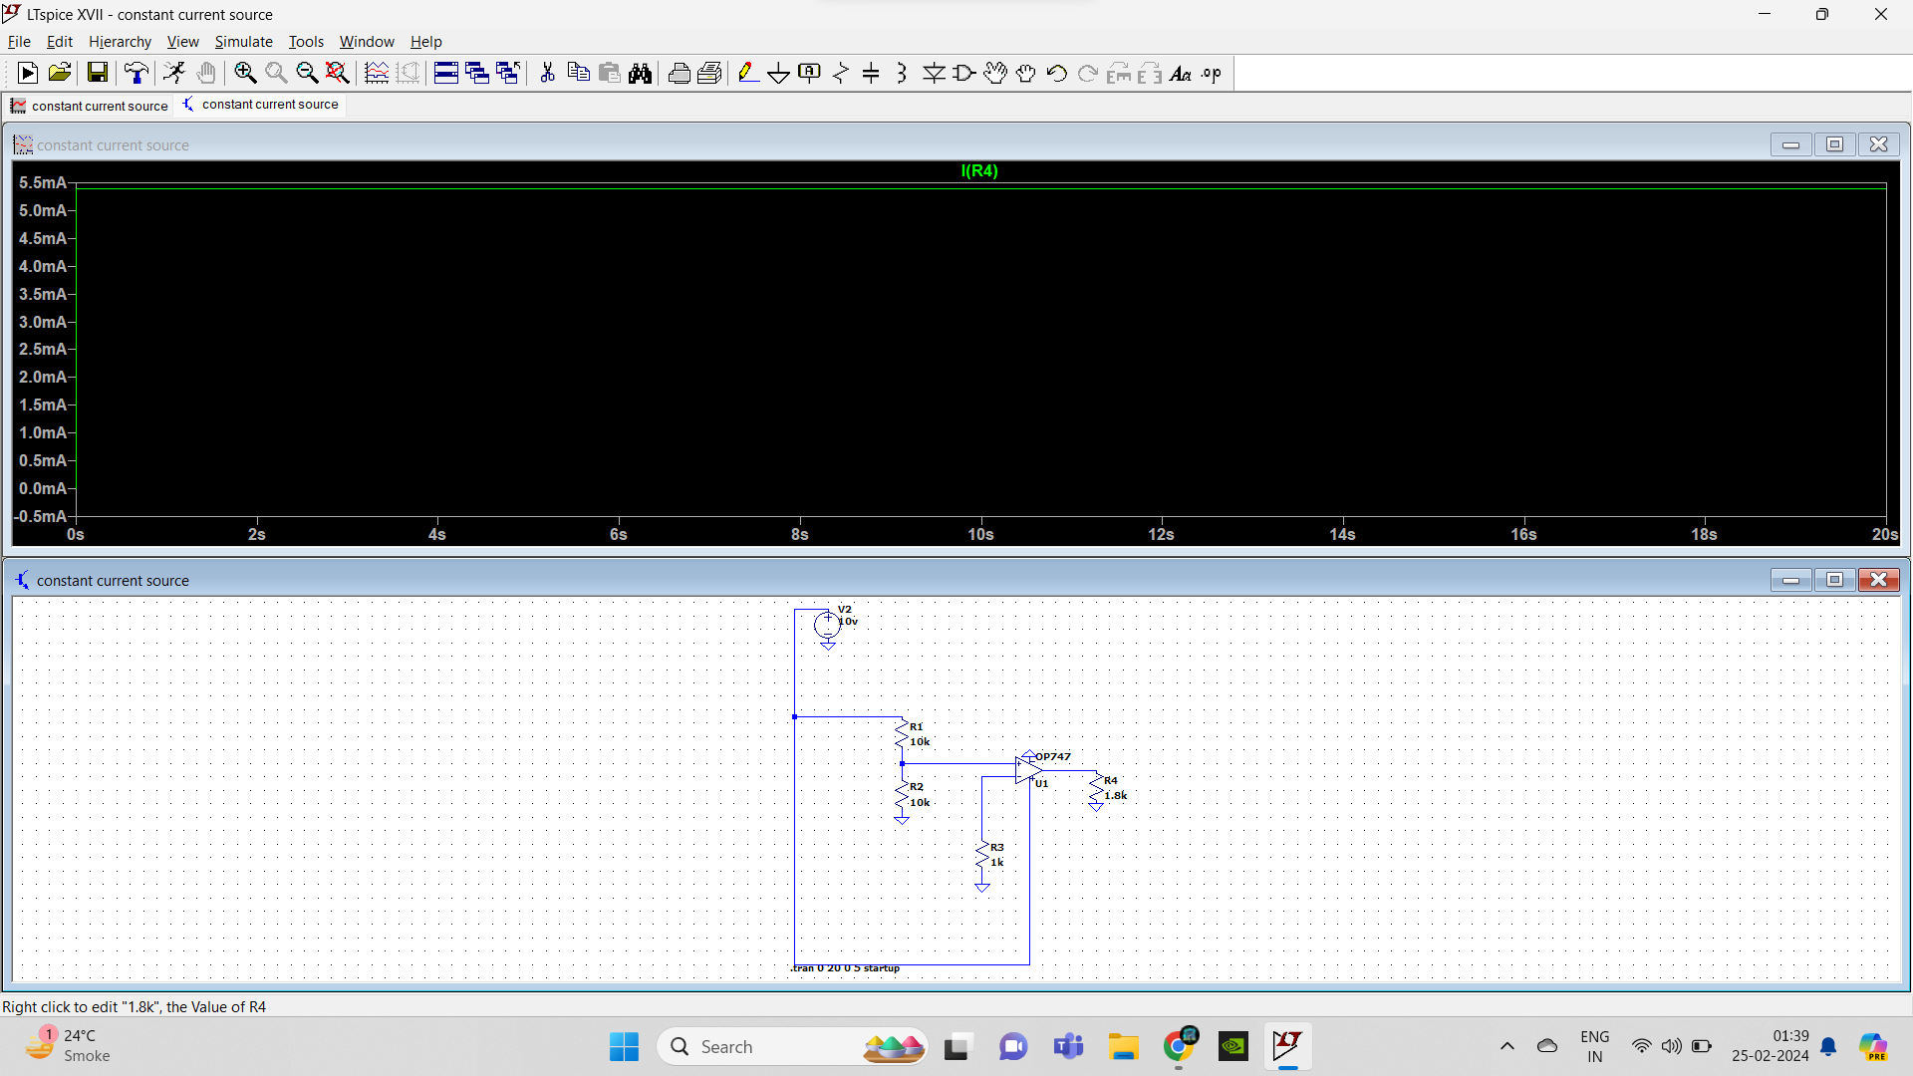
AC CURRENT SOURCE :

Slide 21
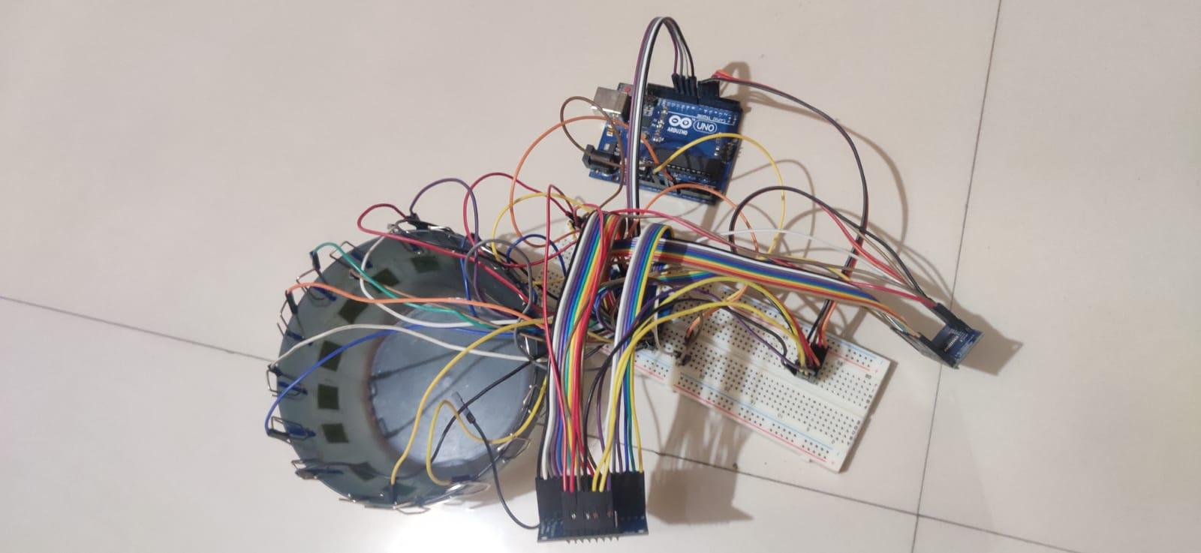
HARDWARE :

Slide 22
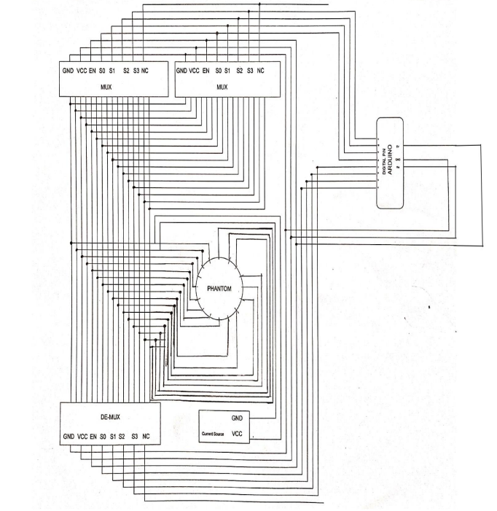

Slide 23

OUTPUT :

Slide 24
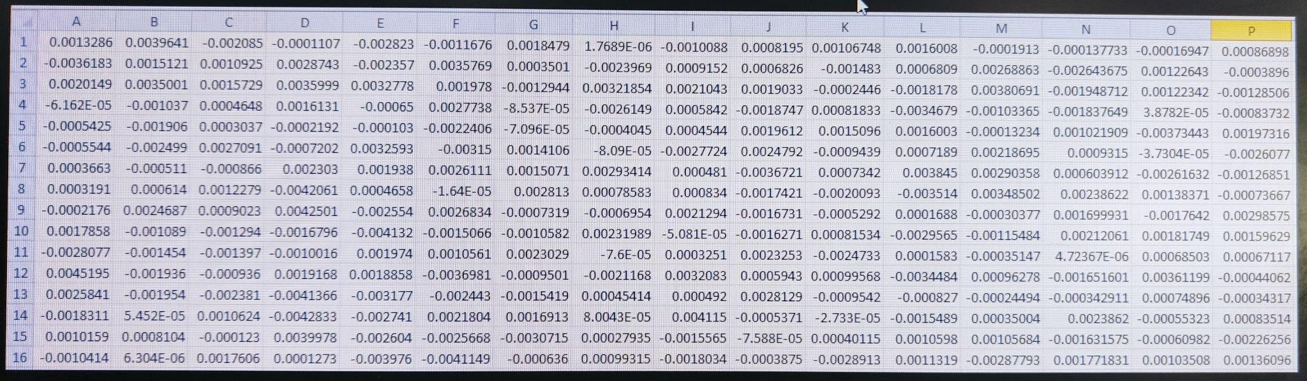

Slide 25
APPLICATIONS :
Medical Imaging:
Lung Imaging
Brain Imaging
Breast Cancer Detection
2. Industrial Processes:
Process Monitoring:
Quality controls
Monitoring Fluid distribution in Pipelines
3. Geophysics:
Study of Earth’s subsurface properties

Slide 26
Future Implementations :
Developing Code on MATLAB / ARDUINO for Output Readings
Studying various Reconstruction Algorithms
Developing code on MATLAB for Image Reconstruction

Slide 27
References :
[1] Tushar Kanti Bera and Nagaraju Jampana A Multifrequency Constant Current Source Suitable for Electrical Impedance Tomography (EIT).
Proceedings of 2010 International Conference on Systems in Medicine and Biology, 16-18 December 2010, IIT Kharagpur, India.
[2] Priya Hankare , Dr. Alice Cheeran Comparison of image reconstruction algorithms for finding impurities utilising EIT for clinical application in breast cancer.
Int. J. Medical Engineering and Informatics, Vol. 14, No. 6, 2022
[3] Priya Hankare , Dr. Alice Cheeran An Automated Portable and Noninvasive Approach for Breast Tumor Findings using 2 D Electrical Impedance Tomography in Early Stage.
[4] Tushar Kanti Bera and Nagaraju Jampana https://docs.google.com/document/d/1ZAAfQKnfCvJ3JNMbpE-T6rU-mMiu9X2YtKgaDKwPKSA/edit Denyer C. W. L., Electronics for Real-Time and Three-Dimensional Electrical Impedance Tomographs, PhD Thesis, Oxford Brookes University, January 1996
[5] Metherall P. Three Dimensional Electrical Impedance Tomography of the Human Thorax, PhD Thesis, University of Sheffield. Jan’ 1998.

Slide 28
References :
[6] Huang C. N., Yu F. M. and Chung H. Y., The Scanning Data Collection Strategy for Enhancing the Quality of Electrical Impedance Tomography, IEEE Transactions on Instrumentation And Measurement, Vol. 57, NO. 6, 2008
[7] Yorkey, T. J., Comparing reconstruction methods for electrical impedance tomography PhD thesis, University of. Wisconsin at Madison, Madison, WI 53706, 1986
[8] Gang, Y., K. H. Lim, R. George, G. Ybarra, and W. T. Joines. A 3D EIT system for breast cancer imaging. IEEE Proceedings of the 3rd International Symposium on Biomedical Imaging. 2006.
[9] Holder; D. S., Hanquan Y. and Rao A., Some practical biological phantoms for calibrating multifrequency electrical impedance tomography, 1996 Physiol. Meas. 17 A167-A177
[10] Hope T A. and Iles; S E, Technology review: The use of electrical impedance scanning in the detection of breast cancer, Breast Cancer Res 2004, 6:69-74 © 2004 BioMed Central Ltd.

Slide 29
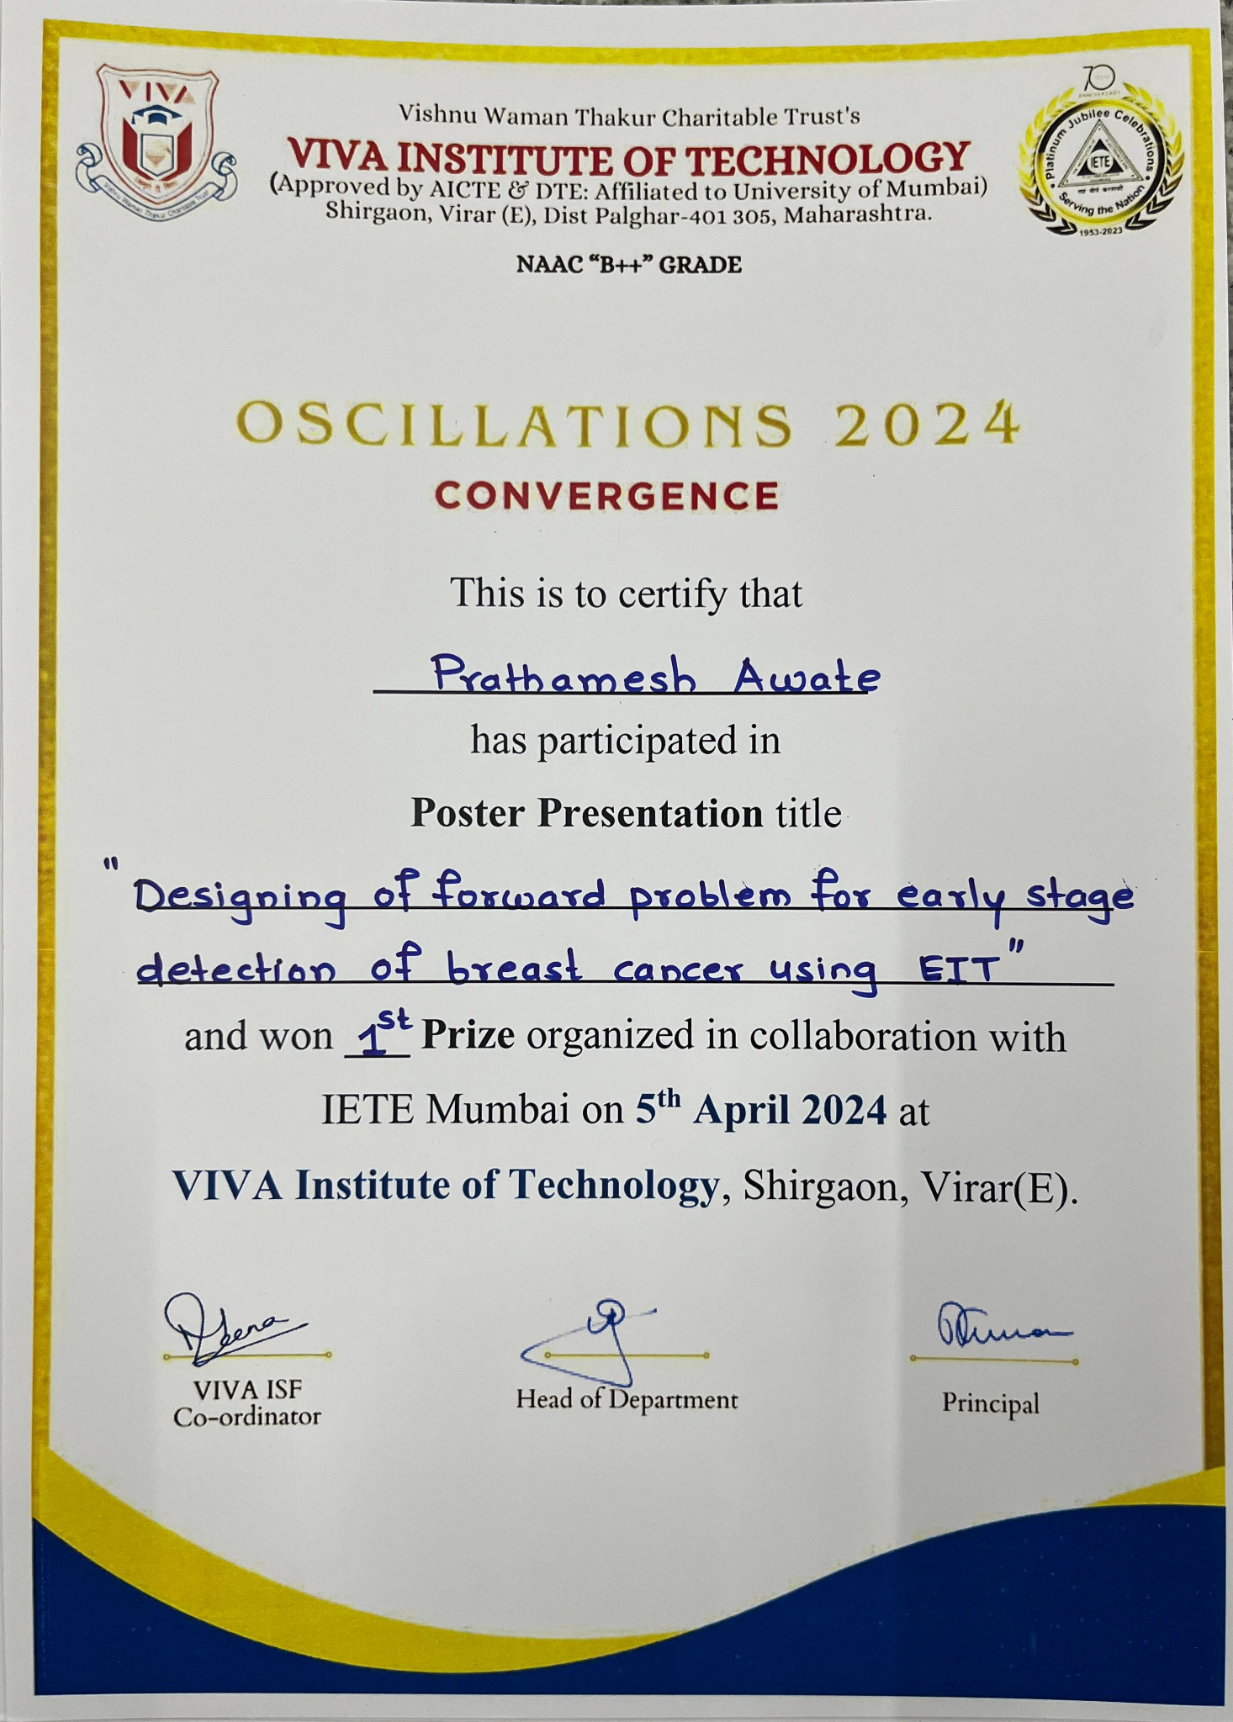

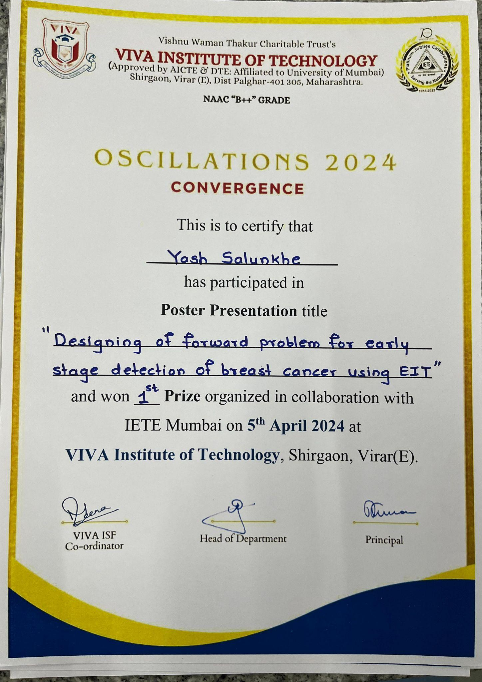
Certificates

Slide 30
Thank You

